Slide 1
PROJECT INTRODUCTION
Project Name: OBH012 COMBO-Z 3200 48V UPS
Objective- Export Sales team required Static UPS 2800W with 48V battery bank and Some new different looks like New Bezel and Graphical LCD with Multi color.
Scope-On battery voltage range 42V to 58V, Maintain output current more than and equal to 9A at full load 2800w . Chassis must be compact from existing system.
Measurement Goals - Schedule Variance:±20%,Product Defect Density:0.10±0.02,Project’s Process Defect Density:0.20±0.02.
Link to Project Data :http://192.168.100.9:8080/svn/LKVA_inv/OBH012/
Team Size: 11 Nos.
Effort Size: 195 .28 hrs.
Timeline : 08-09-2022 to 27-10-2022
Actual Scheduled Start to Finish Date: 08-9-2022 to 31-10-22
Target Customer :Export Market

Slide 2
Requirement Development and Management Flow
Modified
Capture Requirement and Analysis
Approval
Make the FS and RTT
Develop the conceptual design document of hardware, Firmware, Mechanical
Make the module test cases and design implementation
Requirement Change Request
Make the system test case and validation
Module testing and integration test case

Slide 3
Verification & Validation
Verification
Need of customer/ Requirement
Specification
Product
Process
Validation

Slide 4
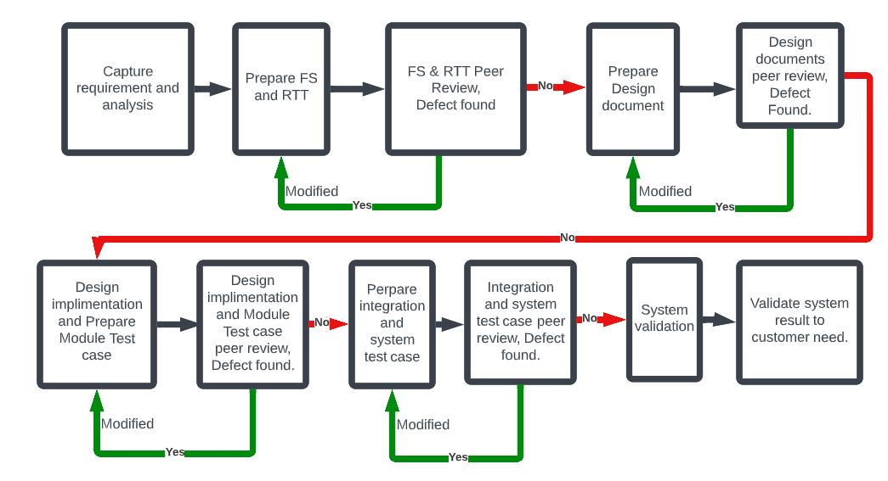
Peer Review

